Slide 1
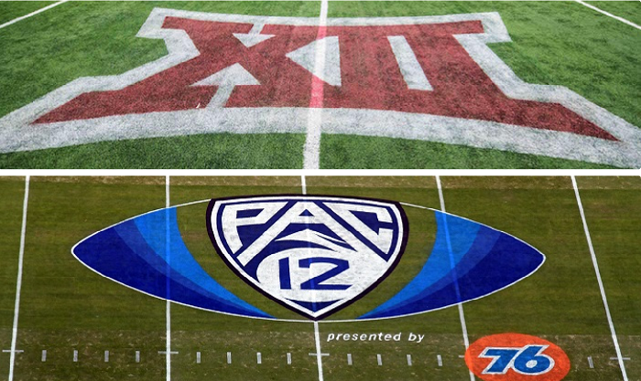
Pac 12 fantasy football app
By Matthew Van Winkle, Andrew Logue, Ethan Trapp, and Nathan Young

Slide 2
Elevator Pitch
Our project was built to give college fantasy fans a more manageable fantasy league and application. The goal was to create an app that was easily accessible even to those that don’t want to learn everything there is to know about football across the entire nation. To accomplish this we altered the standard fantasy format to not be a competitive drafting process and to be isolated to one conference of college football: The Pac 12.
The product: A website that allows users to draft a team of 11 players from the pac 12 and then compete at a national level against all other users as well as in user created leagues. This app updates weekly with teams scores using players stats as the scoring metric.

Slide 3





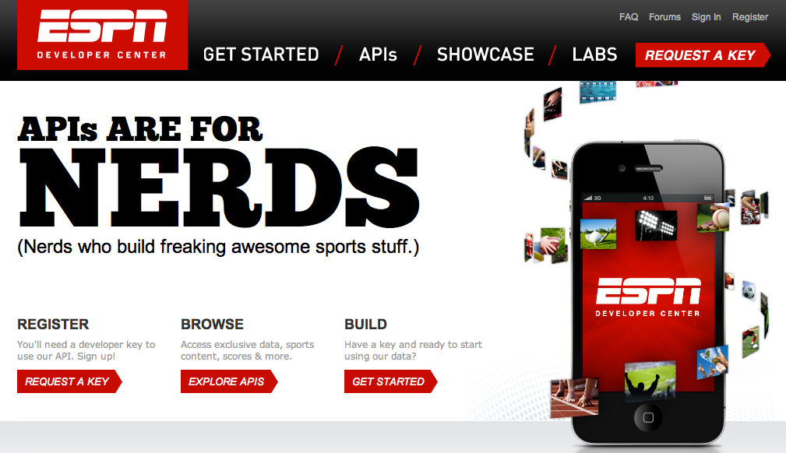

Project Tracking: Github projects 4/5
VCS repository: Github 5/5
Database: MySql 3/5
IDE: VsCode 4/5
UI Tools: EJS and html. 3/5
Application Server: Node js 2/5
Deployment environment: Local host and CS internal servers
External APIs: ESPN college football 4/5
Zoom for regular group and peer meetings: 4/5

Slide 4
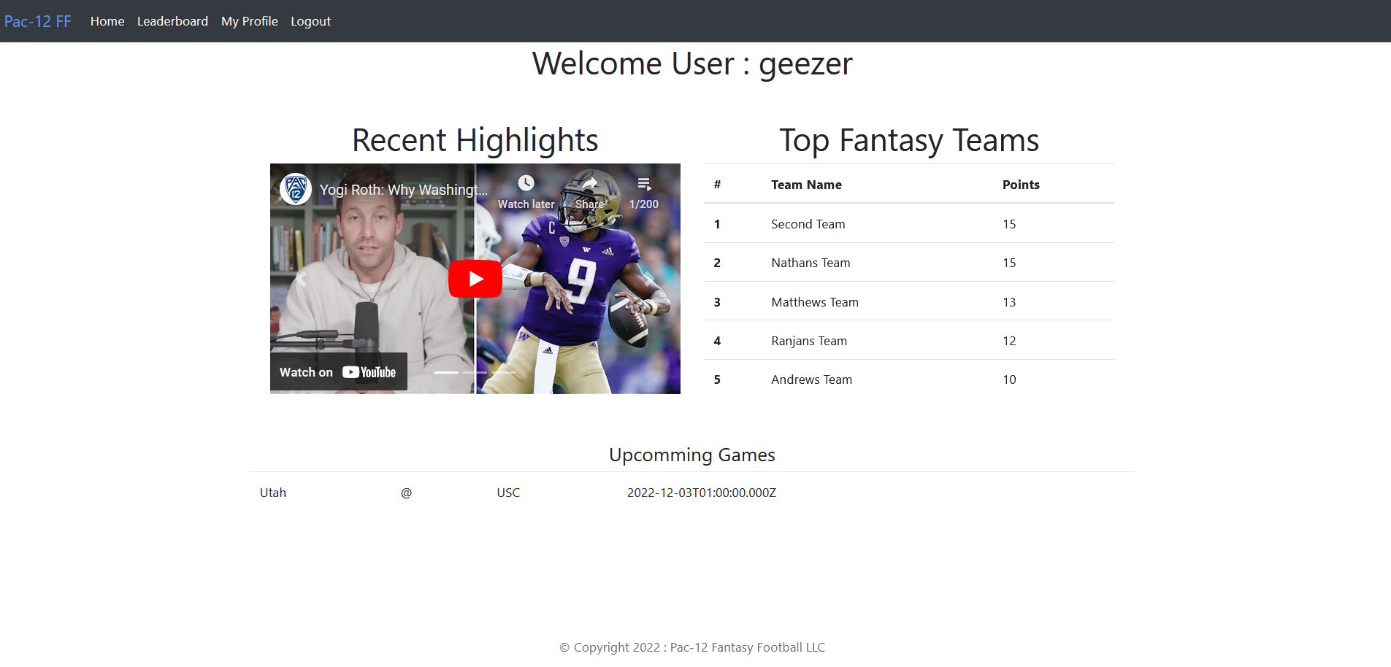
Ethan and Andrew present the product

Slide 5
Ranjan presents challenges
During our project we encountered three main challenges, the first was learning how to use agile software development on a real project. Between figuring out how to communicate, setting meeting times, and organizing who was doing what it was a complicated first week. We overcame this organizational challenge by using github projects, becoming more active in our group chat, and meeting more regularly both as an entire group and individually on zoom.
The second challenge we encountered was connecting our front end code with our sql databases. We had hard coded tables displaying but when we switched to pulling the table from SQL we encountered issues. We overcame these complications by referencing previous labs, meeting as a group, and sharing our progress through our improved communication so we could help each other.
The third challenge we faced was the scope of our project. When we set out we had planned for a much more complicated interwoven system of leagues, teams, and users. As we worked on the project and discussed our limitations we realized we had let our ideas get ahead of our skills. In order to combat this, we met as a group and discussed what we were each capable of and how we could transform the project to both fulfill our original goals and to match our skill sets.
The fourth challenge we faced was lack of communication from our final group member. We aren’t sure he is still in the class.

Slide 6
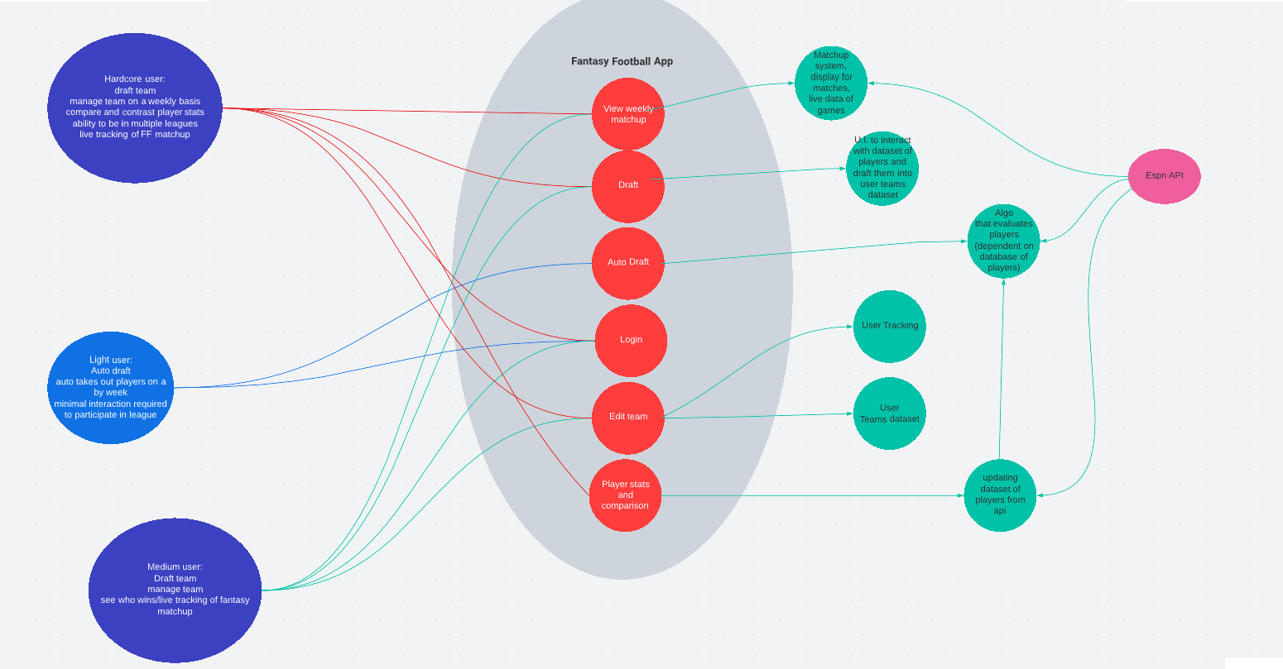
Challenges Continued (Initial project vs final result)

Slide 7
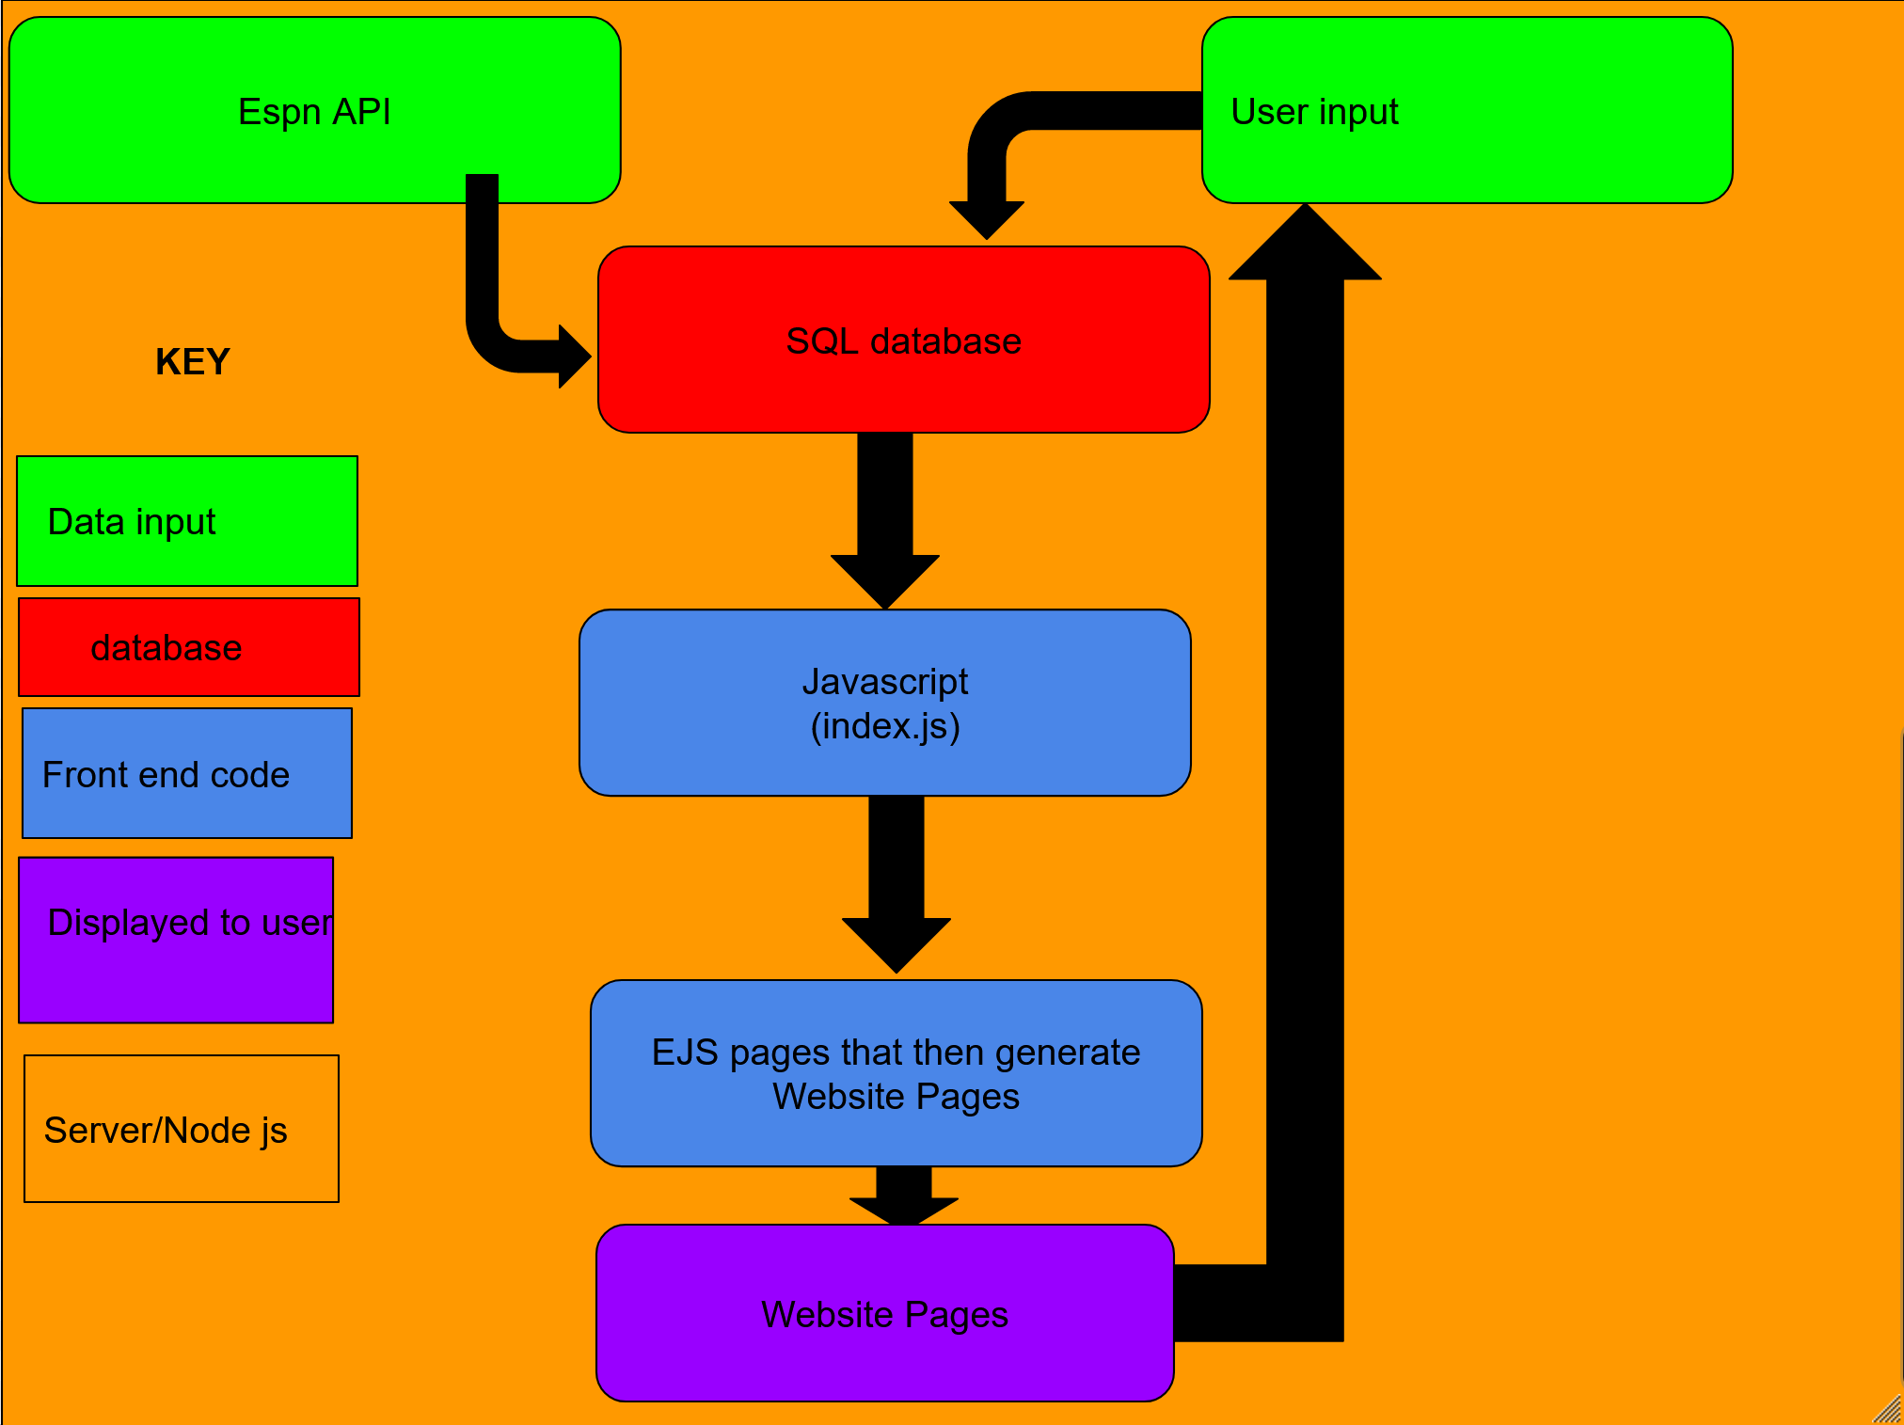
Matthew Van Winkle: Diagram and user testing

